Slide 1
Audio Acoustic Assistant
Mid-Point Presentation
Group 14

Slide 2
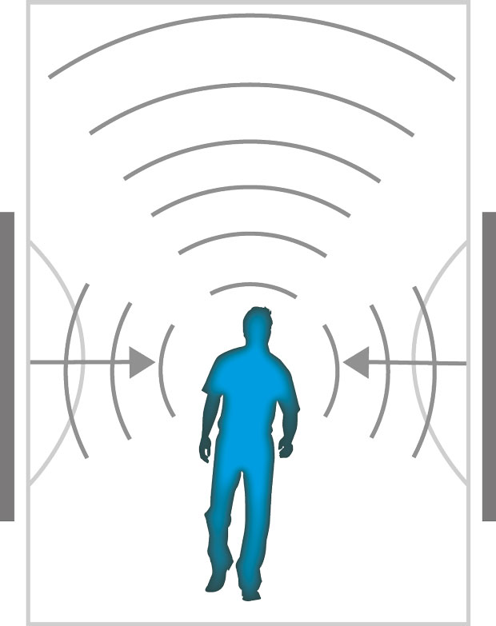
Introduction
What is Audio Acoustic Assistant?
The idea
What it is all about
The feasibility of the app
Who is it made for?
Why is it being made?
What is the market?
Why is it important?
How will it be implemented?
(KNAUF DANOLINE A/S, n.d.)

Slide 3
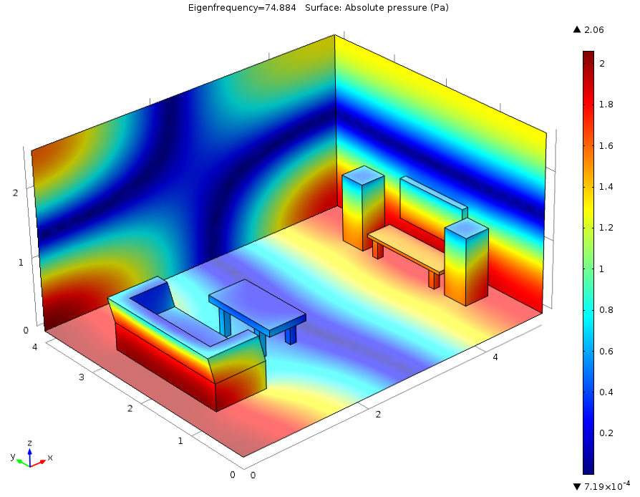
App Overview
What can the app do?
Sound input
Determine the length of a sound until it disappears.
Calculate the correct reverb time
Aid to generate perfect acoustic environment
for recording (acoustic treatment).
What can’t the app do?
Tune instruments
Media player
(Mads Herring Jensen & COMSOL Inc, 2015)

Slide 4

Progress on the Project
What has been done?
Proposal
Requirements
Android Studio - Tutorials
What is happening now?
Android Studio – coding
What is next?
Android Studio – more coding
Testing
Implementation
Final submission
(Software Plant, 2017)

Slide 5
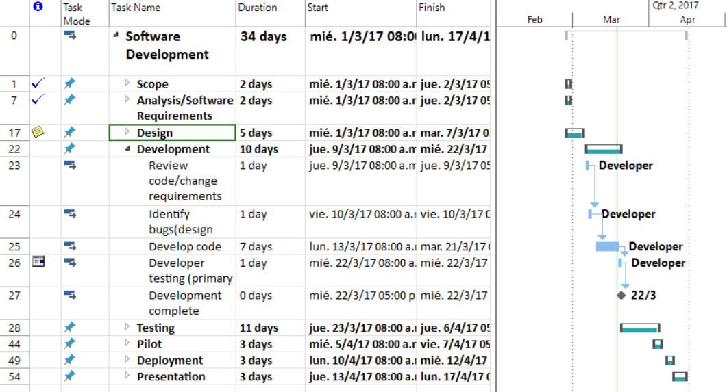
Work Breakdown Structure
Used with permission from Microsoft.

Slide 6
Demonstration of the App

Slide 7
References
KNAUF DANOLINE A/S, n.d., image, viewed March 2017, <http://knaufdanoline.com/properties/acoustics/>.
Mads Herring Jensen & COMSOL Inc, 2015, image, viewed March 2017, <https://www.comsol.com/blogs/modeling-room-acoustics-with-comsol-multiphysics/>.
Software Plant, 2017, image, viewed March 2017, <http://www.softwareplant.com/migrating-ms-project-jira/>.
canadian1strealty, 2012, photograph, viewed March 2017, <https://canadian1strealty.wordpress.com/2012/11/13/5-nice-things-we-can-do-for-our-clients/
MS Office, 2017, WBS crated march 2017.

Slide 8

Audio Acoustic Assistant
Colin Allen,
Keith Feeney,
Patrick Lawlor,
Fearghal McMorrow,
Cedric Vecchionacce
(canadian1strealty, 2012)

